Slide 1
Giting Good with Git
September 18, 2017
Data Science Society at Berkeley
Anna Leskova

Slide 2
What’s Git???
version control system
tracking changes in computer files
coordinating work on those files among multiple people
aimed at
speed
data integrity
support for distributed, non-linear workflows
Notes:
distributed version control, also known as distributed revision control or decentralized version control, allows many software developers to work on a given project without requiring them to share a common network
https://git-scm.com/doc

Slide 3
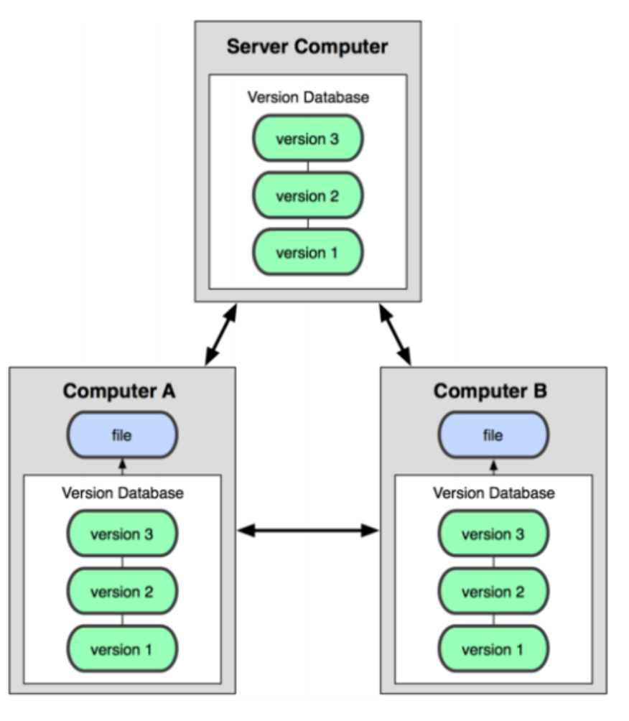
Distributed Version Control System
“clone” and “pull” from a central repo
local repo is complete copy of everything on the remote server
many operations are local
check in/out form local repo
commit changes to local repo
local repo keeps version history
when done “push” back to the server
Notes:
Older VCS – Centralized VCS:
holds “official copy” of code
server maintains the sole version history of the repo
“checkouts” of local copy
local modifications
changes are not versioned
when done “check in” back to the server
checkin increments repo’s version

Slide 4
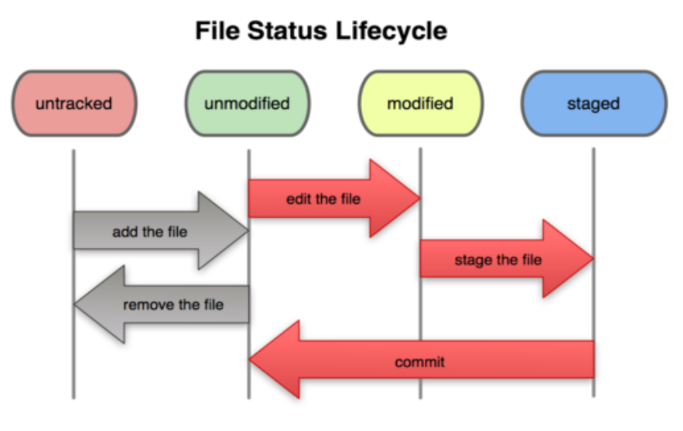
Basic Git Workflow
Modify files in your working directory
Stage files, adding snapshots of them to your staging area
Commit which takes the files in the staging area and stores that snapshot premanently to your Git repository

Slide 5
Initial Git Configuration
Set the name and email for Git to use when you commit:
git config --global user.name “Anna Leskova"
git config --global user.email aleskova@berkeley.edu
Set the editor that is used for writing commit messages: (Optional! – default editor is vim)
git config --global core.editor nano

Slide 6
Creating a Git Repository
To create a new local Git repo in your current directory
git init
will create a .git directory in your current directory
now you can commit files in that directory into the repo
git add filename
git commit –m “commit message”
-m indicating a message
To clone a remote repo to your current directory:
git clone url localDirectoryName
create the given local directory, containing a working copy of the files from the repo

Slide 7
Git Commands
Command | Description
git clone url | copies a remote repository
git add file | adds file contents to the staging area
git commit | records a snapshot of the staging area
git status | view the status of your files in the working directory and staging area
git help [command] | get help info about a particular command
git pull | fetch from a remote repo and try to merge into the current repository
git push | push data or branches to a remote repository

Slide 8

Undoing Changes
undo changes before commiting them
git reset HEAD -- filename
unstages the file
git stash -- filename
undoes all your changes

Slide 9
Viewing Changes
view status of files in working directory and staging area
git status
view the status of your files in the working directory and staging area
git log
See all the changes that your local repo went through
git log -- oneline
git log -5

Slide 10
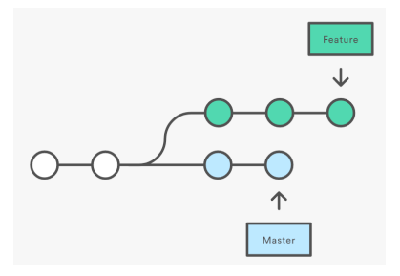
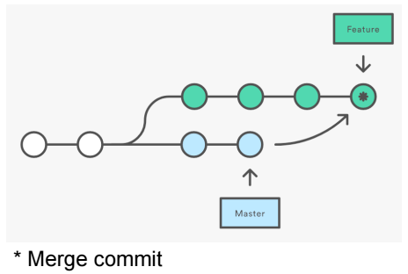
Branching and Merging
To create a new local branch
git branch branchname
To list all local branches
git branch
To switch to a given local branch
git checkout branchname
git merge branchname
Merging con:
Merge commit every time you make upstream changes

Slide 11
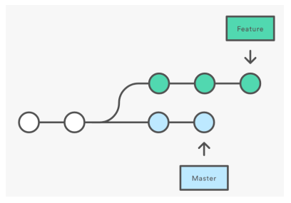
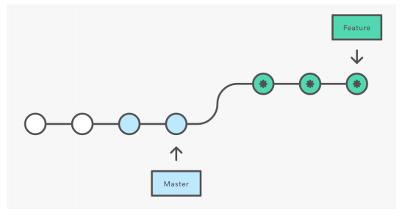
Rebase
Merging con:
Merge commit every time you make upstream changes
Rebase pro:
cleaner git log history, linear history

Slide 12
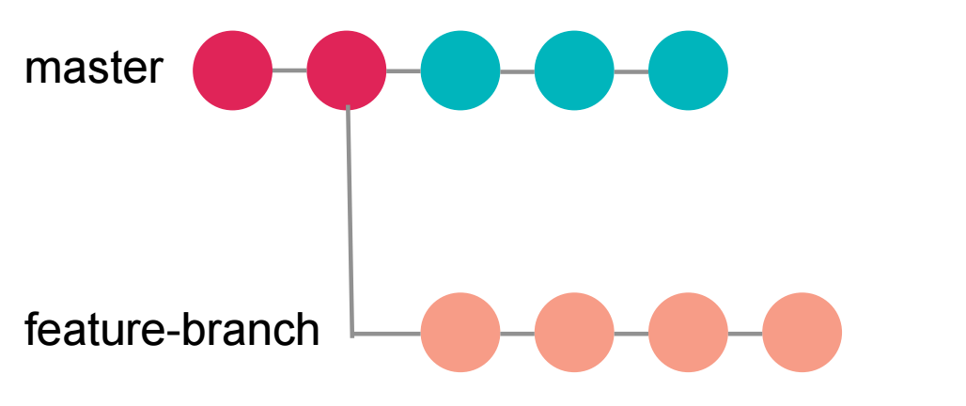
Rebase Awesomness
You can update your feature branch with changes from master, keeping linear history
It’s like you checked out master just now and made your changes on top

Slide 13
Rebase Awesomness
You can update your feature branch with changes from master, keeping linear history
It’s like you checked out master just now and made your changes on top

Slide 14
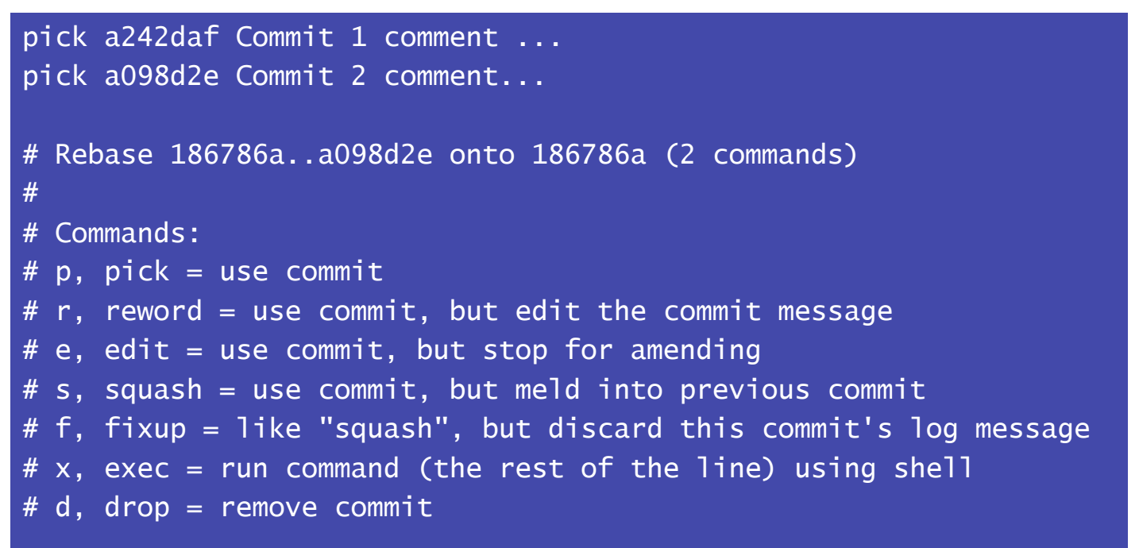

Rebase Example
git rebase –i master
To edit the last 4 commits within a branch’s own commits
git rebase –I HEAD~4
You can drop commits, squash several commits into one, edit commit messages

Slide 15
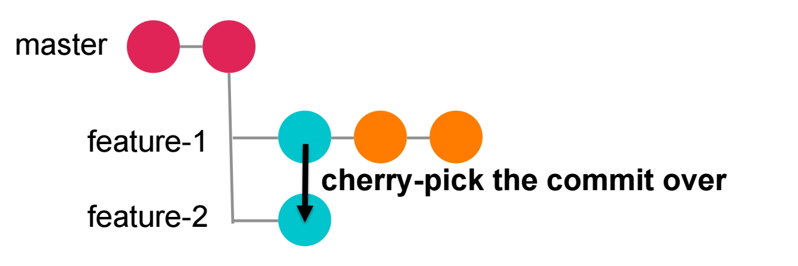
git cherry-pick
To copy a commit from another branch into this branch
git cherry-pick a242daf7d03e0

Slide 16
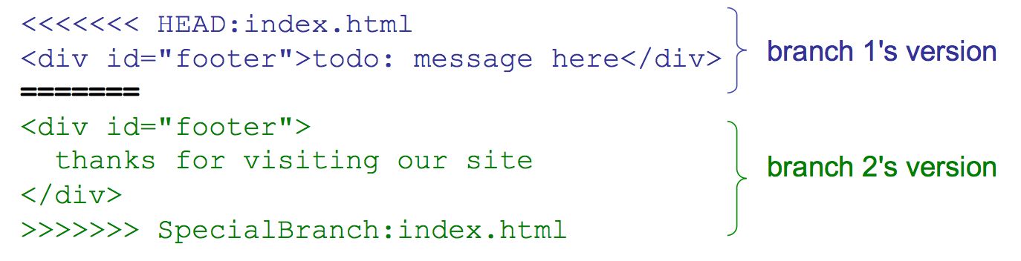
Merge Conflicts
merge conflict happens when two branches both modify the same region of a file and are subsequently merged
git can't know which of the changes to keep, and thus needs human intervention to resolve the conflict

Slide 17
Real Life Example - Google
1 billion files totaling 86 TB
9 million source files– rest is configuration data, generated files, documentation, etc
2 billion LOC
35 million commits
45,000 commits per day– 15K humans, 30K by build pipeline– 15MLOC in 250K files changed every week by humans (~size of Linux kernel)

Slide 18

GitHub
GitHub is a site for online storage of Git repositories
you can create a remote repo there and push code to it
You can get free space for open source projects
free private repos for educational use: github.com/edu

Slide 19
Installing Git
https://git-scm.com/downloads

Slide 20
Extra - Git Some Resources
Git documentation: https://git-scm.com/doc
Git command glossary: https://www.atlassian.com/git/glossary
Git tutorial with Bitbucket: https://www.atlassian.com/git/tutorials/learn-git-with-bitbucket-cloud
Git for computer scientists:

